Slide 1


Online Investments Tool for FY 2013-14
Payroll Team
SAP Labs India Pvt Ltd
April 2013

Slide 2
Features of online tool
  The on-line tool will help you to update your proposed Investment plan and actual investment proof submission for the Financial Year 2013-2014
  The proposed investment details needs to be updated by you during the beginning of the Financial Year and can be changed whenever you want to change your Investment Plan
  You need to submit the Actual Investment Proofs to payroll after updating in the system by using the given Link, at any time during Jan’14 to Mar’14 along with Investment Declaration Form
  Medical , Telephone and LTA bills needs to be submitted along with the claim form as and when the employee incurs the expenditure after updating the link
  It also help you to know the current status of your claims on-line (i.e. whether its under process or accepted or not accepted for want of clarification, etc)
  All the details updated on or before 15th of every month will be considered in the same month payroll process, else would be considered in next month payroll (Last date only for April 2013 is 22nd .)

Slide 3
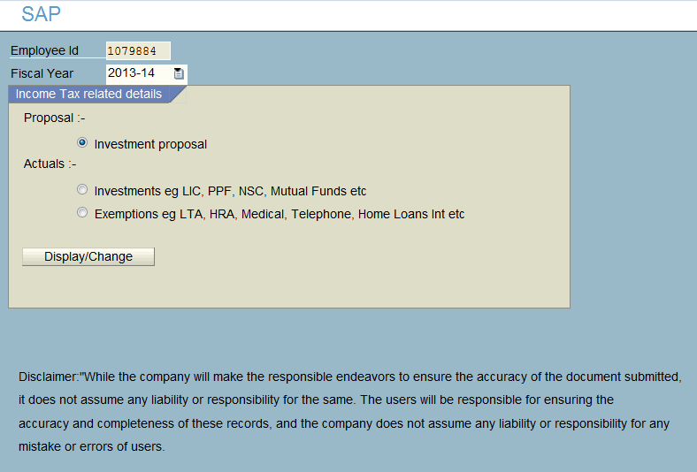
Investment proposal
Step 1
Click on the Investment proposal
Step 2
Click on Display / Change Button
( This will take you to the next screen )

Slide 4
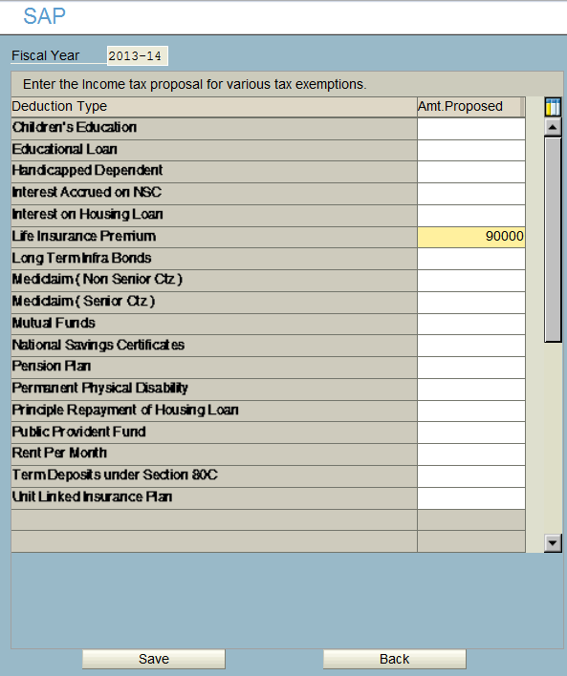
Investment proposal contnd..
Step 1
Select the type of investment under Which you would like to invest
Step 2
Enter the correct amount
Step 3
Click on the Save Button to see the following message

Slide 5
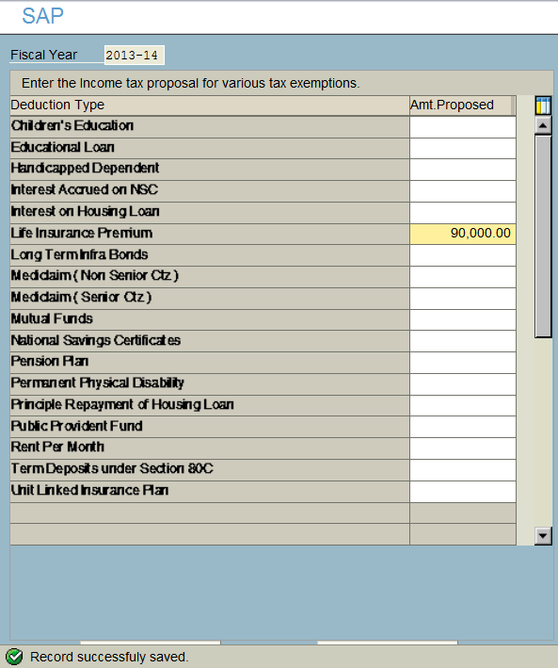
Investment proposal contnd..
Your proposed Investment
Plan for the year 2013-14
has been updated

Slide 6
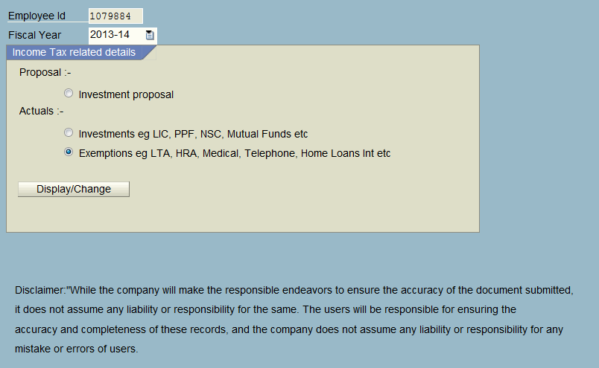
Submission of actual investment proof/s
Step 1
Click on the Actuals
(For Medical Telephone, LTA etc)
Step 2
Click on Display / Change Button
( This will take you to the next screen )

Slide 7
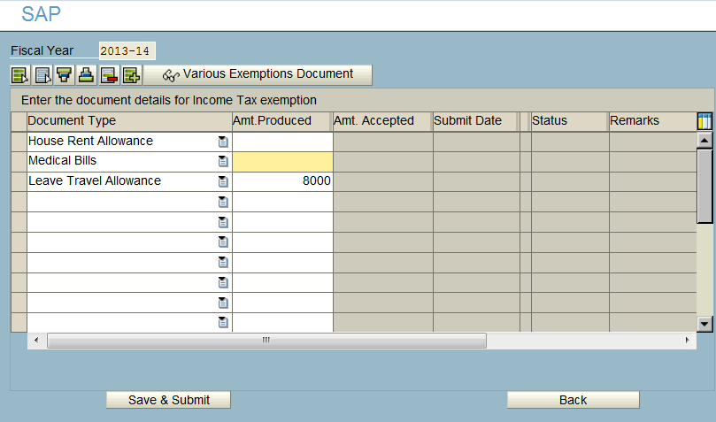
Submission of Medical , Telephone, HRA, LTA Etc…
Step 1
Select the component that you would Like to submit ( Ex: Medical bills, Telephone Bills etc )
Step 2
Enter the amount
Step 3
Click on Save and Submit button
Step 4
Download the Claim form from the
Portal, attach the original bills and send it across to Finance

Slide 8
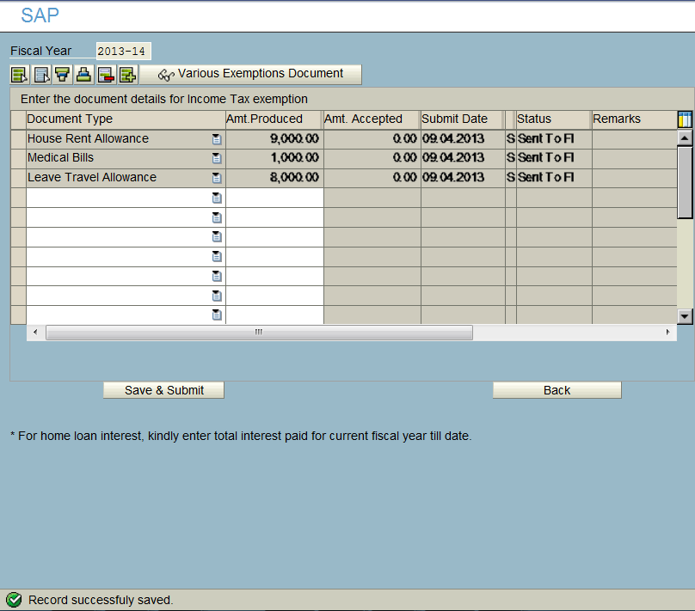
Submission of Medical, Telephone,HRA, LTA Etc…
Step: 5
Ensure that the status is “ Sent to FI”.
Step:6
Ensure that the record is saved.

Slide 9
Thank You!
E-mail – hrdirectapj@sap.com
  Phone – Bangalore: 7300
  Gurgaon :7316

